Slide 1

Structural identifiability analysis of epidemic models based on differential equations
Gerardo Chowell, PhD Professor of Epidemiology and Biostatistics
Information included in this PowerPoint has been adapted from
Chowell, G., Dahal, S., Liyanage, Y. R., Tariq, A., & Tuncer, N. (2023). Structural identifiability analysis of epidemic models based on differential equations: a tutorial-based primer. Journal of Mathematical Biology, 87, 79. https://doi.org/10.1007/s00285-023-02007-2

Slide 2
Today’s Agenda
Overview of structural identifiability
Methods for structural identifiability analysis
Differential algebra approach
Case Studies and Examples
Summary

Slide 3



Parameter identifiability analysis
Identifiability analysis: Describes whether it is possible to uniquely estimate model parameters from a given set of data.
Structural Identifiability: Determines if the model is structured to uniquely reveal its parameters from perfect, noise-free observational data. If structurally unidentifiable, different parameter sets can produce the same output.
Practical Identifiability: Considers the actual data, including noise, to determine if parameters can be reliably estimated in practice.
Let the model and observations be represented in the following compact form
$$x^{′}\left(t\right)=f\left(x,p\right)$$
$$y\left(t\right)=g\left(x,p\right)$$
$$x\left(0\right)=x_{0}$$

Slide 4
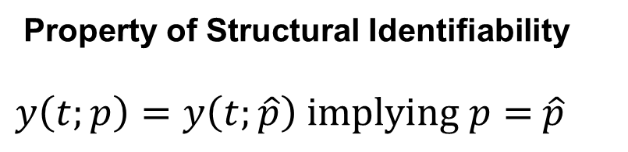
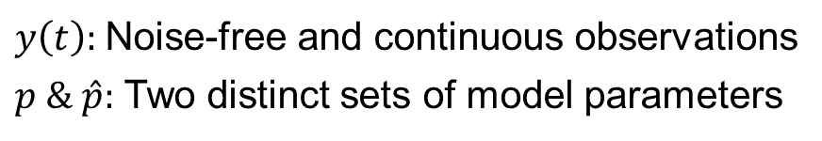
Structural Identifiability Analysis
Structural Identifiability: The model is structured to uniquely reveal its parameters from perfect, noise-free observational data. Therefore,
Property of Structural Identifiability
$y\left(t;p\right)=y\left(t;\hat{p}\right) implying p=$ $\hat{p}$
$y\left(t\right):$ Noise-free and continuous observations
$p \& \hat{p}:$ Two distinct sets of model parameters
It is an inherent attribute of the model (i.e., depends on model structure) and DOES NOT depend on the data.
Chowell et al. Journal of Mathematical Biology. 2023

Slide 5
Methods for Structural Identifiability Analysis
Differential Algebra Method
Uses differential algebra to derive input-output equations, eliminating unobserved variables; handles complex models, requires symbolic computation software (e.g., DAISY, Mathematica).
Taylor Series Method
Expands model equations into a Taylor series; simple for small models, computationally intensive for large ones.
Direct Test Method
Tests uniqueness of parameter values by solving model equations for different parameter sets; straightforward, impractical for models with many parameters.
Symbolic computation
Differential algebra
Generating series
Input-output relationship analysis
Observability and Controllability (e.g., Structuraldentifiability.jl)
Lie derivatives

Slide 6
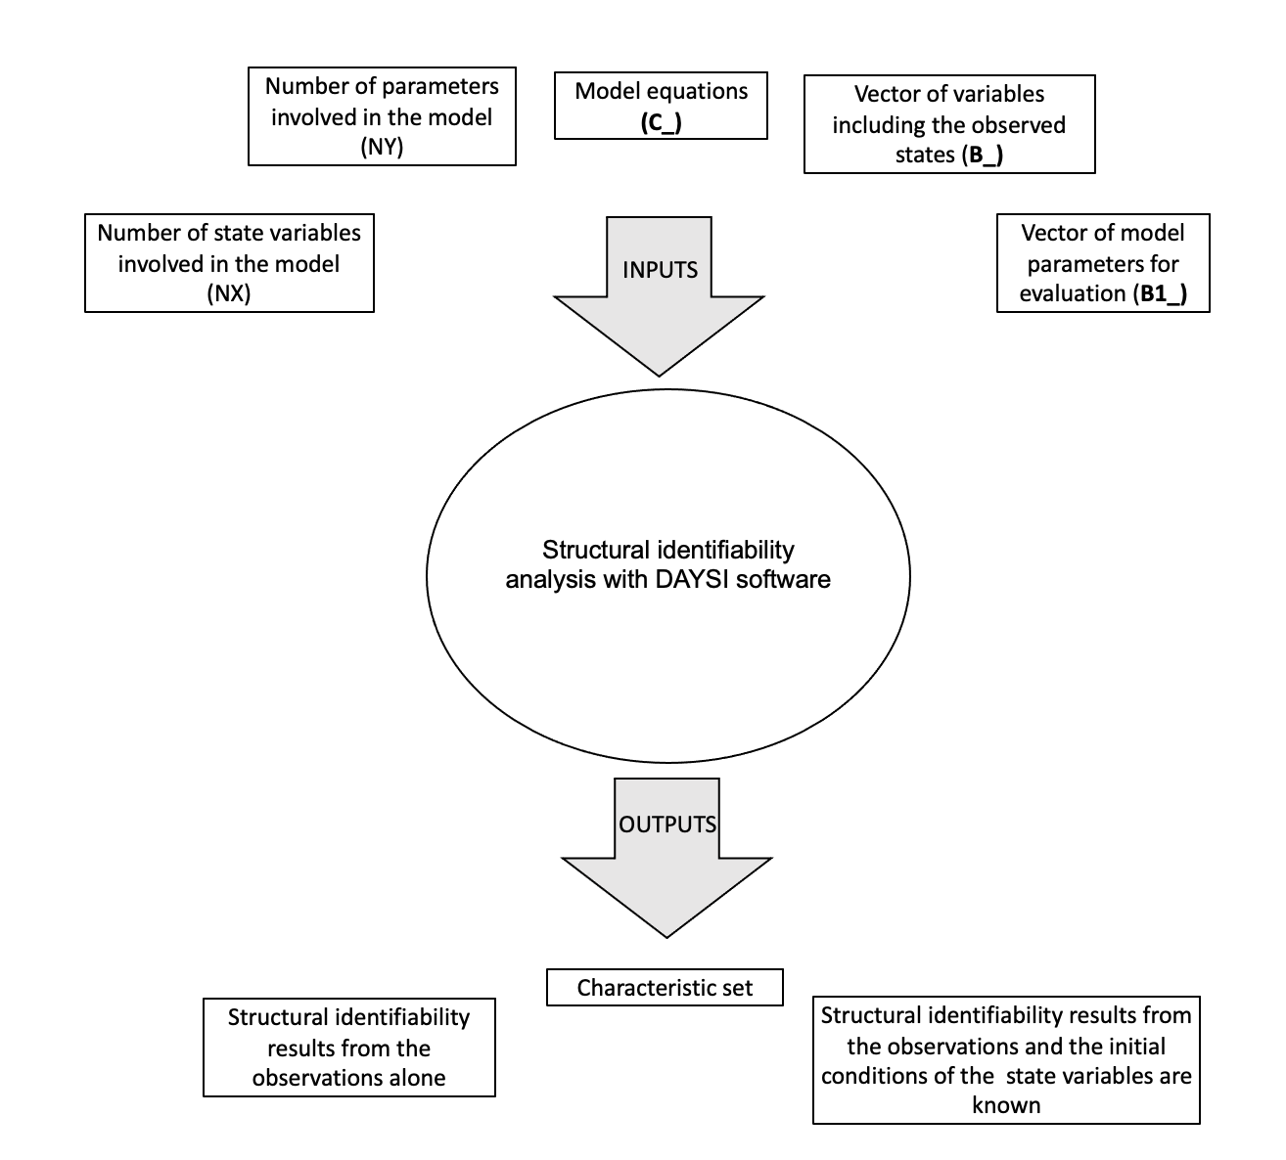
Structural identifiability components
Schematic diagram that shows the input and output components associated with structural identifiability analyses conducted using differential algebra with DAISY software.
Chowell et al. Journal of Mathematical Biology. 2023

Slide 7
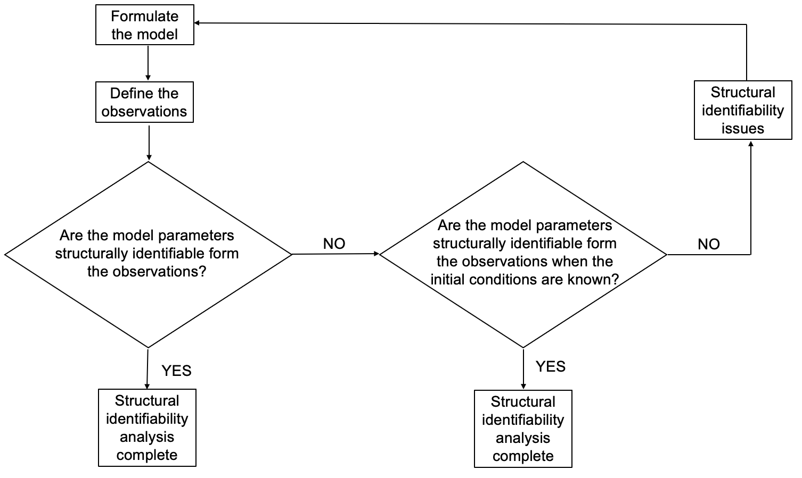
Workflow for conducting structural identifiability
Chowell et al. Journal of Mathematical Biology. 2023

Slide 8

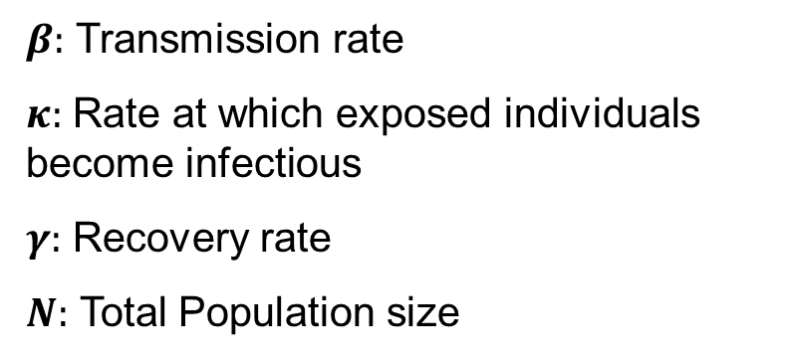
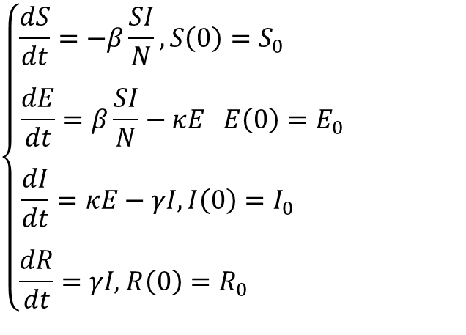
Example 1: Susceptible-Exposed-Infectious Recovered (SEIR) Model
Describes the spread of infectious diseases in a closed population.
$$\left\{\begin{aligned}\frac{dS}{dt}=−β\frac{SI}{N}, S\left(0\right)=S_{0} \\ . \\ \frac{dE}{dt}=β\frac{SI}{N}−κE E\left(0\right)=E_{0} \\ . \\ \frac{dI}{dt}=κE−γI,I\left(0\right)=I_{0} \\ . \\ \frac{dR}{dt}=γI\text{,} R\left(0\right)=R_{0} \end{aligned}\right.$$
$β:$ Transmission rate
$κ:$ Rate at which exposed individuals become infectious
$γ:$ Recovery rate
$N:$ Total Population size
The primary observation is the number of new infected cases over time given by:
$$y_{1}=κE(t)$$

Slide 9
Example 1: Structural identifiability results
Adapted from Chowell et al. Journal of Mathematical Biology. 2023

Slide 10

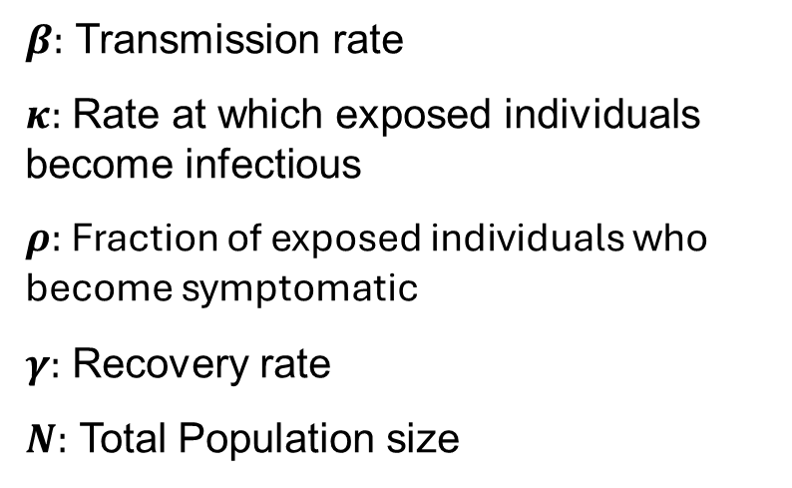
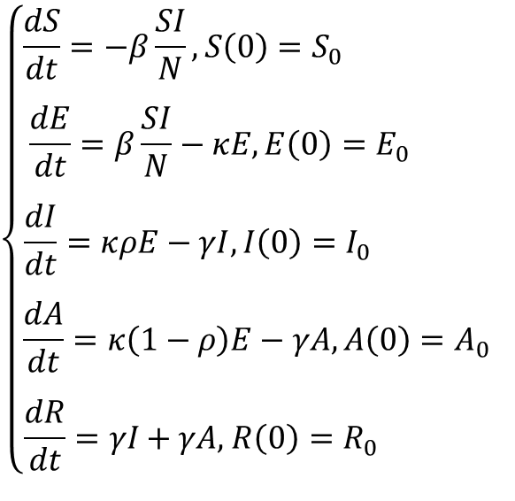
Example 2: SEIR model with symptomatic and asymptomatic infections
Extends the traditional SEIR model to incorporate symptomatic and asymptomatic infections providing a more detailed representation of disease transmission dynamics
$$\left\{\begin{aligned}\frac{dS}{dt}=−β\frac{SI}{N}, S\left(0\right)=S_{0} \\ . \\ \frac{dE}{dt}=β\frac{SI}{N}−κE, E\left(0\right)=E_{0} \\ . \\ \frac{dI}{dt}=κρE−γI,I\left(0\right)=I_{0} \\ … \\ \frac{dA}{dt}=κ\left(1−ρ\right)E−γA,A\left(0\right)=A_{0} \\ . \\ \frac{dR}{dt}=γI\text{ + }γA\text{,} R\left(0\right)=R_{0} \end{aligned}\right.$$
$β:$ Transmission rate
$κ:$ Rate at which exposed individuals become infectious
$ρ:$ Fraction of exposed individuals who become symptomatic
$γ:$ Recovery rate
$N:$ Total Population size
The primary observation is the number of new infected cases over time given by:
$$y_{1}=κρE(t)$$

Slide 11
Example 2: Structural identifiability results
Adapted from Chowell et al. Journal of Mathematical Biology. 2023

Slide 12

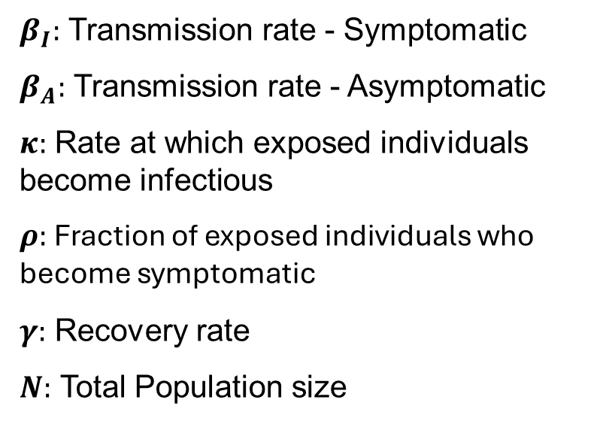
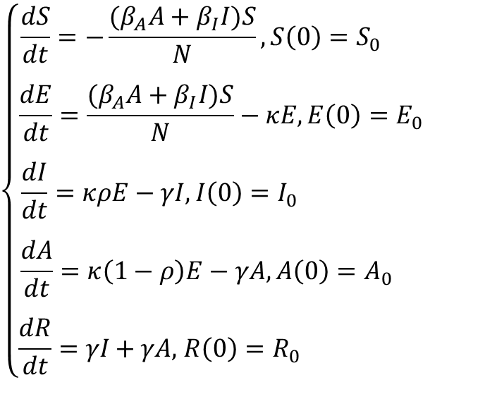
Example 3: SEIR model with infectious asymptomatic individuals
Extends the traditional SEIR model to incorporate symptomatic and asymptomatic infections where both groups are considered infectious and have different transmission rates
$$\left\{\begin{aligned}\frac{dS}{dt}=−\frac{{(β}_{A}A+β_{I}I)S}{N}, S\left(0\right)=S_{0} \\ . \\ \frac{dE}{dt}=\frac{{(β}_{A}A+β_{I}I)S}{N}−κE, E\left(0\right)=E_{0} \\ . \\ \frac{dI}{dt}=κρE−γI,I\left(0\right)=I_{0} \\ … \\ \frac{dA}{dt}=κ\left(1−ρ\right)E−γA,A\left(0\right)=A_{0} \\ . \\ \frac{dR}{dt}=γI\text{ + }γA\text{,} R\left(0\right)=R_{0} \end{aligned}\right.$$
$β_{I}:$ Transmission rate - Symptomatic
$β_{A}:$ Transmission rate - Asymptomatic
$κ:$ Rate at which exposed individuals become infectious
$ρ:$ Fraction of exposed individuals who become symptomatic
$γ:$ Recovery rate
$N:$ Total Population size
The primary observation is the number of new infected cases over time given by:
$$y_{1}=κρE(t)$$

Slide 13
Example 3: Structural identifiability results
Adapted from Chowell et al. Journal of Mathematical Biology. 2023

Slide 14
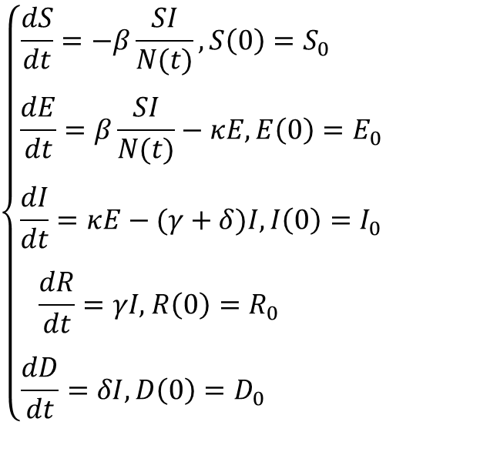

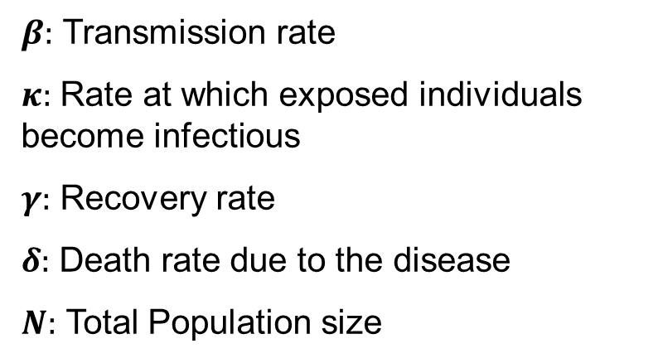
Example 4: SEIR model with disease-induced deaths
Extends the traditional SEIR model to account for disease-induced deaths by adding an additional compartment to represent the deceased population.
$$\left\{\begin{aligned}\frac{dS}{dt}=−β\frac{SI}{N(t)}, S\left(0\right)=S_{0} \\ . \\ \frac{dE}{dt}=β\frac{SI}{N(t)}−κE,E\left(0\right)=E_{0} \\ . \\ \frac{dI}{dt}=κE−(γ+δ)I,I\left(0\right)=I_{0} \\ . \\ \frac{dR}{dt}=γI\text{,} R\left(0\right)=R_{0} \\ .. \\ \frac{dD}{dt}=δI, D\left(0\right)=D_{0} \end{aligned}\right.$$
$β:$ Transmission rate
$κ:$ Rate at which exposed individuals become infectious
$γ:$ Recovery rate
$δ:$ Death rate due to the disease
$N:$ Total Population size
The primary observation is the number of new infected cases over time given by:
$$y_{1}=κE(t)$$

Slide 15
Example 4: Structural identifiability results
Adapted from Chowell et al. Journal of Mathematical Biology. 2023

Slide 16
Structural identifiability results based on additional observations
Adapted from Chowell et al. Journal of Mathematical Biology. 2023

Slide 17
Summary
Ensuring structural identifiability is crucial before estimating model parameters from observational data.
Identifiability guarantees that each parameter can be uniquely estimated from perfect, noise-free data.
Knowing the initial conditions can make previously unidentifiable parameters identifiable.
A structurally identifiable model may still face practical identifiability challenges if the data quality is poor.
Incorporating prior knowledge or fixing certain parameters can help achieve structural identifiability.
Some parameters may be unidentifiable due to correlations with other parameters.
When only a limited subset of the system's states is observed, identifiability issues are more likely to occur.
Including multiple types of observations can help resolve identifiability issues.

